Slide 1

Department of Electronics and Telecommunication Engineering
Agribot : Plantation and AI Driven Quality Insights
Presented by :
Vaibhav Nrupnarayan
Harish Bagul
Abhiman Bade
Guide:
Dr. Kavita Joshi

Slide 2
Index
Problem Identification
Literature Survey
Methodology
Probable Outcomes
Approximate Budget
Project Planner
Conclusion
References

Slide 3

2
Problem Identification
Snakes in Rice fields and bushes :
1
Issue: Danger to the farmers life due to the hazardous insects and snakes.
Impact: This can cause issues such as not sufficient labour for the work into the fields.
2
Inconsistent Quality Control:
Issue: Ensuring high and consistent rice quality is challenging without comprehensive quality control measures.
Impact: Variability in rice quality can affect market value and consumer trust.
Insufficient Labour Power:
3
Issue: Due to high labour requirement and uncomfortable conditions for for farmer due to rice planting field.
Impact: Highly paid labour, cost effective on the overall rice farming.

Slide 4
Objectives
Main Objective:
Specific Goals:
Implement Rice plantation Agribot to Reduce labour costs and manual errors.
Achieve a improvement in rice quality through AI-driven crop quality control measures.
Identify potential issues after specific period from the day plantation to spray the fertilizers before the crucial impact on the crop.
Smart and continuous farming through optimized rice planting machinery.
Develop an, Agribot, machinery to enhance the quality of rice plantation through crop quality detection and rice planting aiming for increased yields through the use of the innovative solution that can help poor and moderate farmer.

Slide 5
Literature Survey
Sr.no | Paper Name | Methodology | Result
1 | Smart farming for improving agricultural management | Here the cloud based event and data management is done using the cloud system, connecting the different sensors to the cloud and analyze the collected data. | Collection of the data and analyzing it for the future procedure on the crops on the fields according to the quality of the plants.
2 | Application of AI techniques and robotics in agriculture | Normal application of AI in detecting the trees, leaves and other factors like detecting the fruits and quality by using image processing and neural network topology, raspberry Pi and the display | Detecting the objects in the fields using AI and deciding the objects.

Slide 6
Literature Survey
Sr. no | Paper Name | Methodology | Result
3 | Design and development of the agricultural robot for crop seeding | Here the fully functional agricultural mini robot is made which can drop the seeds automatically into the fields with the help of arduino, ir sensor, ultrasonic sensor and motors. | The seed of the plant can be sowed without the human requirements with this automated seed planter robot.
4 | Detection of unhealthy region of plant leaves using Image Processing and Genetic Algorithm | 1. Artificial neural network (ANN) 2. CIELAB color model 3. Color co-occurrence method with SVM classifier | An ANN based classifier classifies different plant diseases and uses the combination of textures, color and features to recognize those diseases. It is used to remove that noise. The training samples can be increased and shape feature and color feature along with the optimal features can be given as input condition of disease identification.

Slide 7
Literature Survey
Sr.no | Paper Name | Methodology | Result
5 | Effect for a Paddy Weeding Robot in Wet Rice Culture | 1. Navigation Algorithm (PWM control as the basic navigation control) 2. Capacitive touch sensors 3. Azimuth sensor | The ground is uneven, and the rows of rice seedlings are not always straight, as is the case in terraced paddies. It is used to detect rice seedlings and Measure the movement direction.
6 | Robotics and Automation in Agriculture: Present and Future Applications | 1. Real-Time Kinematic GPS (RTK-GPS) and IMU 2. Fuji F660EXR Camera 3. Normalized Different Spectral Indices (NDSI) | This new technology is used for position and attitude sensor for navigation system. To monitor the seed falling trajectories which is attached at the Unissem pneumatic planter outlet. It is used in detecting peanut leaf spots.

Slide 8


Methodology
System Design:
Components:
Data Collection and Integration (Sensors, Data Aggregation)
AI and Analytics Engine(Machine Learning Models, Analytics Dashboard)
Hardware
Software
Data Collection Hardware
Data Processing and Storage
AI and Analytics Engine

Slide 9
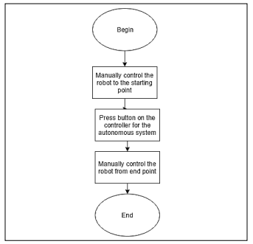

Methodology
Hardware Architecture:
Here is the architecture of the hardware which the rice planter will work and the different actions will be taken by the machine.

Slide 10
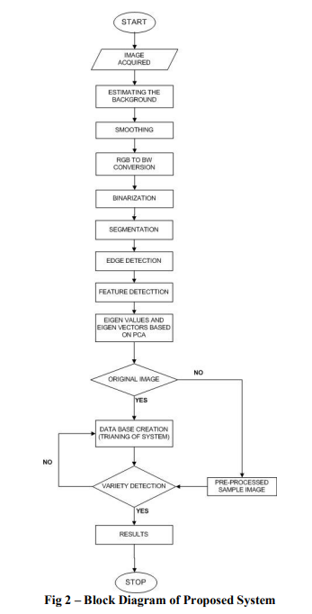
Methodology
Software Architecture:
Here is the block diagram of the software with which we can detect the quality of the rice plant. The Machine Learning is used to detect the difference between the good quality product and the bad quality product.

Slide 11
Approximate Budget
Approximate Budget : 13,000 Rs – 16000 Rs includes:
- Raspberry pi 4 : 6000
- chassis and rice planter: 2000
- Raspberry Pi Camera Module V2-8 Megapixel: 3000
- Power transmission unit: 2500
- DC 12v Stepper Motor : 2000
- Motor controller : 300
- Other : 1500

Slide 12
Project Planner
Months Activities | JULY’24 | AUG’24 | SEP’24 | OCT’24 | NOV’24 | DEC’24
Literature Reviews | √ | √
Component Identification & Selection |  | √
Designing
Experimental Analysis
Fabrication
Testing and Debugging
Preparation of Project Report

Slide 13
Probable Outcomes
Increased Production of the Crop:
Improved rice yields due to resource management.
Enhanced Quality Control:
Achieve a improvement in rice quality.
Resource Efficiency:
Reduction in water and fertilizer use, contributing to sustainable practices.
Adoption and Impact:
No need to pay high salary to the labor by the farmers, leading to less the overall cost and improve profitability.
Environmental Benefits:
Significant reduction in environmental impact through optimized resource use.

Slide 14
Conclusion
Agribot: Rice Plantation and AI-Driven Quality Insights aims to revolutionize rice farming by integrating AI technology with real-time data monitoring to optimize water management, enhance crop quality, and promote sustainable practices. By addressing the inefficiencies and challenges in traditional rice farming, Agribot seeks to improve yields, reduce resource usage, and achieve high-quality production while ensuring environmental stewardship.

Slide 15
References
1] Effect for a Paddy Weeding Robot in Wet Rice Culture Hitoshi Sori∗, Hiroyuki Inoue∗, Hiroyuki Hatta∗∗, and Yasuhiro Ando∗∗ ∗National Institute of Technology, Tsuyama College 624-1 Numa, Tsuyama-city, Okayama 708-8509, Japan E-mail: sori@tsuyama-ct.ac.jp ∗∗IKOMA Robotech Corporation 634-28 Toshima, Tsuyama-city, Okayama 708-0016, Japan [Received September 20, 2017; accepted February 27, 2018]
2] Smart farming for improving agricultural management Elsayed Said Mohamed a,⇑ , AA. Belal a , Sameh Kotb Abd-Elmabod b , Mohammed A El-Shirbeny a , A. Gad a , Mohamed B Zahran a aNational Authority for Remote Sensing and Space Sciences (NARSS), Cairo 11843, Egypt b Soils & Water Use Department, Agricultural and Biological Research Division, National Research Centre, Cairo 12622, Egypt
3] Image Processing Techniques for Diagnosing Rice Plant Disease: A Survey Prabira Kumar Sethya *, Nalini Kanta Barpandaa , Amiya Kumar Rathb , Santi Kumari Beherab a Department of Electronics, Sambalpur University, Jyoti Vihar, Burla and 768019, India b Department of Computer Science and Engineering, Veer Surendra Sai University of Technology, Burla and 768017, India
4] Rice Grain Identification and Quality Analysis using Image Processing based on Principal Component Analysis Muhammad Junaid Asif [1], [4], Tayyab Shahbaz [2], Dr. Syed Tahir Hussain Rizvi [3], Sajid Iqbal[1] [1] Department of Mechatronics & Control Engineering, University of Engineering & Technology, Lahore. [2] Department of Electrical Engineering, University of Engineering & Technology, Lahore. [3] Dipartimento di Automatica e Informatica, Politecnico di Torino, Turin, Italy. [4] R&D Engineer, AMBER Capacitors Limited, Lahore, Pakistan.

Slide 16
References
5] ROBOTICS APPLICATION IN AGRICULTURE Pramod Kumar Sahoo,Dilip Kumar Kushwaha, NrusinghCharanPradhan, YashMakwana, Mohit Kumar, MahendraJatoliya,MudeArjunNaik, Indra Mani Division of Agricultural Engineering, Indian Agricultural Research Institute, New Delhi 110012, India.
6] Design and Development of an Agricultural Robot for Crop Seeding Hussain Nor Azmia , Sami Salama Hussen Hajjajb,c* , Kisheen Rao Gsangayaa , Mohamed Thariq Hameed Sultand,e,f* , Mohd Fazly Mailg , Lee Seng Huah aDepartment of Mechanical Engineering, Universiti Tenaga Nasional, Jalan IKRAM-UNITEN, 43000 Kajang, Selangor Darul Ehsan, Malaysia. bCentre for Advanced Mechatronics and Robotics (CaMaRo), Universiti Tenaga Nasional, Jalan IKRAM-UNITEN, 43000 Kajang, Selangor Darul Ehsan, Malaysia
7] Robotics and Automation in Agriculture: Present and Future Applications Mohd Saiful Azimi Mahmud* , Mohamad Shukri Zainal Abidin, Abioye Abiodun Emmanuel and Hameedah Sahib Hasan School of Electrical Engineering, Faculty of Engineering, Universiti Teknologi Malaysia, 81310 UTM Skudai, Johor, Malaysia *Corresponding author: azimi@utm.my Submitted 08 March 2020, Revised 31 March 2020, Accepted 01 April 2020.
8] Detection of unhealthy region of plant leaves using Image Processing and Genetic Algorithm Vijai Singh Asst Professor IMS Engg college Ghaziabad, UP ,India vijai.cs@gmail.com Varsha Asst Professor JSSATE Noida, Uttar Pradesh, India Prof. A K Misra Professor, MNNIT Allahabad, Uttar Pradesh, India
9] A Robot System for Paddy Field Farming in Japan K. Tamaki*, Y. Nagasaka*, K. Nishiwaki*, M. Saito*, Y. Kikuchi*, K. Motobayashi* * National Agriculture and Food Research Organization Tsukuba, Japan (Tel: +81-29-838-8815; e-mail: tama@affrc.go.jp)

Slide 17
Thank You

